Slide 1
Fight for
Video!

Slide 2
1. 设计；绘制 v _____________
2. 设计者；设计师 n _____________
3. 专家；内行 n _____________
4. 可能的 adj _____________
5. 独特的；独一无二的 adj _____________
6. 消极的；被动的 adj _____________
7. 表现；业绩 n _____________
8. （使）振作起来；（使）高兴起来 _____________
design
designer
expert
likely
unique
passive
performance
cheer up

Slide 3
9. 催促；逼迫 v _____________
10. 热切的；渴望的 adj _____________
11. 青年时期 n _____________
12. 冒险 n _____________
13. 可变通的；灵活的 adj _____________
14. be on sb’s back about sth _____________
15. kangaroo n _____________
press
eager
youth
adventure
flexible
缠磨；烦扰
袋鼠

Slide 4
design
一、在空白处填入1个适当的单词或括号内单词的正确形式。
designer
16. Every _______________ (design) hopes that his work can stand the test of time.（20012 上海）
17. This course is designed __________ an introduction to the subject.
18. It is said that the early European playing-cards were designed
_______________ entertainment（娱乐）and education.
as
be designed as... 被设计为
for
be designed for... 为...而设计...

Slide 5
二、根据所给词块，翻译下列句子。
19. 那位设计师的才华给我们留下了深刻的印象。(be impressed with, talent 才华)
__________________________________________________________
20. Whether by chance or by design, it so happened that there were exactly 150 people in the station.
__________________________________________________________
We are very impressed with the designer’s talent.
by design=on purpose
不知是偶然还是有意，车站里正好有150人。

Slide 6
expert
一、在空白处填入1个适当的单词或括号内单词的正确形式。
experts
21. Some (expert) say that women will become more effective managers than men.
22.He making toys. That is why he is quite popular with children.
他擅长做玩具。这就是为什么他很受孩子们的欢迎。
is
expert
at/in

Slide 7
likely
23. If the stress in your life is too much, you are likely ____________ (get) ill.（2016 上海改）
24. The harder you try to beat him, the ______________ (likely) you will get hit.（2014 辽宁）
25. Stephen Hawking believes that the earth is ___________ (likely) to be the only planet where life has developed gradually.（2010 福建改）
26. If one is late for a job interview, he will get the job.
如果一个人面试迟到了，他就不太可能得到这份工作。
to get
more likely
unlikely
it is not likely that

Slide 8
unique
uniqueness
27. n. 独特性
28. Don’t to improve yourself.
不要错过这个独一无二的提升自己的机会。
29. You will get used to his way of doing things which him.
你会习惯他做事的独特方式。
miss
the
unique
opportunity
is
unique
to
passive
被动吸烟；吸二手烟
30. passive smoking
31. When problems arise, we are supposed to deal with it , not .
当问题出现时，我们应该积极地处理它，而不是被动地。
actively
passively

Slide 9
press
32. Be careful! The machine starts the moment you
____________________（按按钮）. (2011 湖北）
33. They are __________________________________（催促我们迅速作决定）.
34. He ______________（继续前行）and finally got passed the finishing line.（2008 广东)
35. The story was reported ___________________________（在报刊和电视上）.
press the button
pressing us to make a quick decision
pressed on
in the press and on television

Slide 10
eager
is eager for
36.After several failures, Mattew success.
37. After several failures, Mattew succeed/be successful.
几次失败后，马修渴望成功。
38. I wasn’t able to hide my when I asked, “What do you wish me do now?”
is eager to
eagerness
youth
39. He was a great football player in his youth.
40. 青年文化
41. the youth of today
42. Old as he is, he is full of enthusiasm.
他虽然老了，却充满了青春的热情。
in sb's youth
某人的青年时期
他年轻时是一名伟大的足球运动员。
youth culture
当代青年
youthful

Slide 11
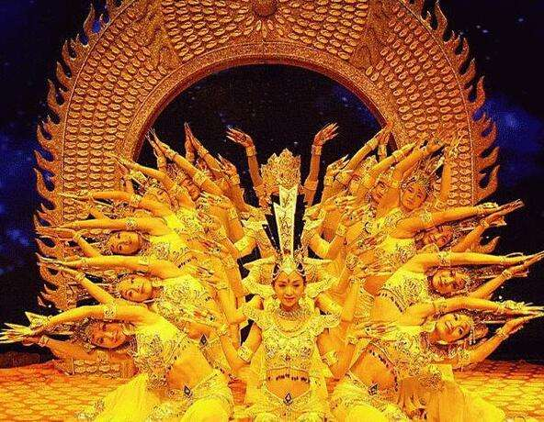
perform & performance
43. “A Buddism godness Guanyin Bodhisattva” is the Chinese national cultural heritage of mankind. It is (perform) by disabled (perform). The (perform) moved the whole China.
performed
performers
performance

Slide 12
performs an important role
44. She _________________________（发挥重要作用）in our organization.
adventure
spirit
adventure
45. 冒险精神 a of .
46. An is someone who is enough to explore the unknown world.
冒险家是那些有足够的冒险精神去探索未知世界的人。
adventurer
adventurous

Slide 13
flexible
一、根据句意，选出下列句子中flexible的释义。
a. 可变通的；灵活的
b. 易弯曲的；柔韧的
47. The inventors said the material becomes flexible when wet, so they’re exploring ways to use it in wet environments.（2012 湖南） ______
48. Schedules tend to be flexible, with business meetings sometimes starting later than planned.（2014 浙江） ______
二、翻译句子。
49. 弹性的工作时间是女性择业考虑的重要因素。
________________________ are a major career consideration for women.
50. 他在这个问题上寸步不让。
He’s completely _______ on the subject.
b
a
Flexible working / work hours
inflexible

Slide 14
2410: 9mins
2412: 9mins
Fight for
Video!

Slide 15
1. 租金 n _____________
2.食品杂货；食品杂货店 n _____________
3. 紧急情况；突发事件 n _____________
4. 自愿 / 无偿；主动说 v _____________
5. 志愿的；自愿的 adj _____________
6. 在 / 往城市的商业区 / 市中心 adv _____________
7. 一个镜头；场景 n _____________
8. 公寓；一套房间 n _____________
9. 回答；反应 n _____________
10. 回答；回应v.
rent
grocery
emergency
volunteer
voluntary
downtown
scene
flat
response
respond

Slide 16
11. accountant n _____________
12. grocer n _____________
13. lap n _________________
14. teller n _____________
15. 提取；支取
16.
17.摇头/点头
18.一个灿烂的笑容
19.改编自
20.数（钱）
会计（员）；会计师
食品杂货商
大腿的上面部分
讲述者；（银行）出纳员
draw sth out of sth
怀着热切的兴趣看着
watch with anxious interest
shake/nod one’s head
a bright smile
be adapted from
count out

Slide 17
account
二、根据所给汉语，完成下列句子。
21. I was a new teacher, and I ______________________（如实报告）the
students’ work.
22. She was told to wear flat shoes, (由于)her back problem.
23. There are certain factors（因素）I _________________（考虑到）on my new invention.
24. Han Chinese _______________（占）91.59% of the Chinese population.
25. 我们绝不能在考试中作弊。
gave an honest account of
on account of
take into account
account for
On no account can we cheat in the exam.

Slide 18
secure & security
写出下列句子中画线部分的汉语释义。
26. Children need to feel secure in order to do well at school. _________
27. We want a secure future for our children. _________
28. She secured the rope firmly to the back of the car. _________
29. She has bought a bicycle and is worried about security. _________
30. It’s standard practice for a company like this one to employ a security
guard. _________
31. This insurance plan offers your family financial security in the event of
your death. _________
32. If it’s a choice between higher pay and job security, I’d prefer to keep my
job. __________
安心的
可靠的未来
拴牢
安全
保安
经济保障
工作保障 / 工作稳定

Slide 19
graduate & graduation
33. I was lucky: I became a pilot in 1970, almost ten years before I graduated _________ medical school.
34. After _________ (graduate), she worked to help her sisters and brothers pay for their schooling.
35. Like many new _________ (graduate), I left university full of hope for the future but with no real idea of what I wanted to do.
from
graduation
graduates

Slide 20
figure
36. It’s important for the figures to be updated regularly.
数字
Being a public figure
37. ________________________（当一名公众人物）today is a lot more difficult than it used to be.
38. In order to _______________________（有一个好身材）, most women try everything to lose weight.
have a good figure
39. No one could (弄明白)how he got to be so wealthy.
figure out

Slide 21
40. The parents are shocked by the news that their son needed ______ operation.
41. First Dr. Robert taught the monkeys to do different jobs, then he operated ________ them.
42. The lab is ________ operation. The move for the Engineers should be completed next week.
43. The plan was soon .(实施;投入使用)
operate & operation
an
on
in
put into operation

Slide 22
gather
44. Every Tuesday afternoon, they _______________（聚在一起）to exchange their ideas on books.
45. _________________________（围着篝火）, the tourists danced with the local people.
46. However serious a problem you may have, you should _________________________（鼓起勇气）to face the challenge.
gather together
Gathering around the fire
gather (up) your courage

Slide 23
scene
47. He’s famous in the music scene. _________
48. At the end of the story, my mind continued the final scene of reunion, on and on, until my own lost dog and I were, in my mind, running together. _________
49. You can take a couple of breaths and think of something that gives you pleasure: a beautiful scene in nature, or someone you love. _________
50. crime scene
音乐界 / 圈
场景
景色
犯罪现场

Slide 24
2410: 27mins
2412: 29mins
Fight for
Video!
B1U3 reading+grammar

Slide 25

12 October
Last Saturday, Jenny had a cold, so we gave up our original plan. However, instead of 1._____________ (恢复) at home, she was out having fun with someone else. When I got the news, I 2.___________ (explode) with anger and didn’t feel like 3.___________ (回应) to any of her online messages. Someone says I shouldn’t be so quick to 4._________ (判断) a friend. Perhaps she knows she’s in the wrong and wants to 5.___________ (道歉). Others hold the opinion that if your friend 6._______ (欺骗) you, 7. _______ (忽视) your feelings or makes you 8._________ (受折磨), it’s time to rethink your relationship.
Do I 9.______________(understand) Jenny? Do I need to 10.________(联系) her?
recovering
exploded
responding
judge
apologize
tricks
ignores
suffer
misunderstand
contact

Slide 26
Verbs
Nouns
recover
respond
judge
apologize
explode
ignore
suffer
misunderstand
contact
trick
recovery
11.
12.
13.
14.
15.
16.
17.
18.
19.
20.
response
judgement/ judgment
apology
explosion
ignorance
suffering
misunderstanding
contact
trick

Slide 27
21. 脱离某人的视线 _________________
22. 社交媒体 ________________
23. 能参加；能出席 ______________
out of one’s sight
social media
make it
24. 感到迷惑；不知所措 ________________
25. 有错；应承担责任 ____________________
at a loss
in the wrong
26. 在任何情况下；不管怎样 _____________
27. 松手；放开；放弃；摒弃 _____________
in any case
let go of
28. on the rocks _____________
（关系或生意）陷于困境；濒临崩溃

Slide 28
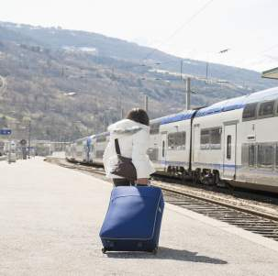
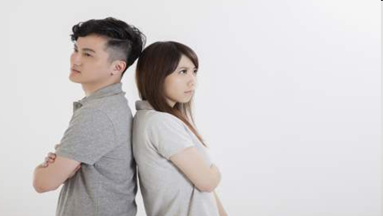
29.
Mary hurried to the train station____________ she might not be able to ___________.
in case
make it
30.
Their marriage has been ____________for a couple of months. Neither of them admit they are ___________ and both of them are __________.
on the rocks
in the wrong
at a loss

Slide 29
Translate the following sentences into English.
31. 这个想法很值得考虑。(be worth sth / doing sth ) _____________________________________________
32. 三千英里是一段很长的距离。(复数名词做主语) _____________________________________________
33. 我怎么能放弃生活中这些美好的东西呢？(let go of)
_______________________________________________
This idea is well worth considering.
Three thousand miles is a long distance.
How can I let go of everything good in my life?

Slide 30
34. She reached the station just as the train ____________(进入视野).
35. Realizing that you have sent an email that could get in trouble, you freeze in (horrible)and burn with shame.
36. (从...判断)her facial expression, she might failed the exam.
37. Jack apologized ______Rose ________ his carelessness.
38. ____________(在这种情况下), anything is possible for those who hang on to hope.
39. We allow them to be left around because we’ve been _________ (ignore) of their value.
40. He has now made a full (recover) from his _________ (suffer).
came into sight
horror
Judging by/from
to
for
In this case
ignorant
recovery
suffering

Slide 31
41-50
On our way to the house, it was raining hard that we couldn't help wondering how long it would take _________(get) there. It was in the middle of Pearl City.
We were first greeted with the barking by a pack dogs, seven to be exact. They were well trained by their masters________ had great experience with caring for these animals. Our hosts shared many of their experiences and recommended the most wonderful places are worth visiting. For breakfast, we were able to eat papayas (木瓜) and other fruits from their trees in the backyard.
so
to get
of
who/that
that

Slide 32
When they were free from work, they invited us to local events and let us know of an interesting (compete) to watch, together with the story behind it. They also shared with us many ______________(tradition) stories about Hawai were hugely popular with tourists. On the last day of our week-long stay, we (invite) to attend a private concert on a beautiful farm on the North Shore under the stars, meeting interesting locals with we listened to musicians together.
competition
traditional
that/which
were invited
whom

